Slide 1
Attack Lab
Yunju Baek

Slide 2
Agenda
Stack review
Attack lab overview

Slide 3
x86-64: Register Conventions
Arguments passed in registers:
%rdi, %rsi, %rdx, %rcx, %r8, %r9
Return value: %rax
Callee-saved: %rbx, %r12, %r13, %r14, %rbp, %rsp
Caller-saved: %rdi, %rsi, %rdx, %rcx, %r8, %r9, %rax, %r10, %r11
Stack pointer: %rsp
Instruction pointer: %rip

Slide 4
x86-64: The Stack
Grows downward towards lower memory addresses
%rsp points to top of stack
push %reg: subtract 8 from %rsp, put
val in %reg at (%rsp)
pop %reg: put val at (%rsp) in %reg,
add 8 to %rsp
Bottom
0x7fffffffffff
%rsp
Top

Slide 5
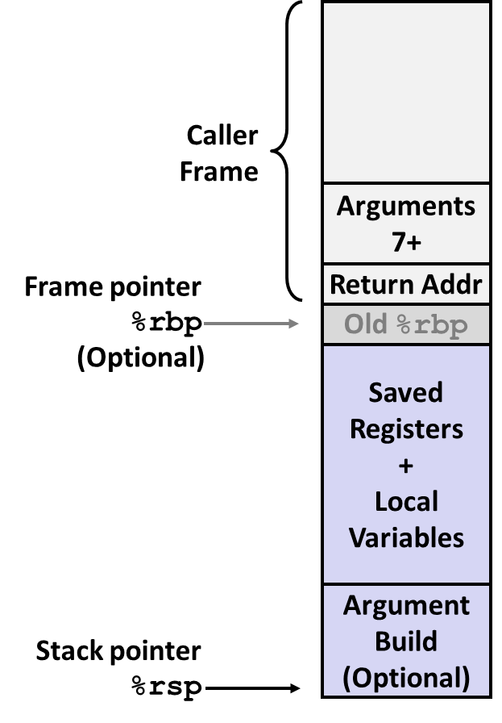
x86-64: Stack Frames
Every function call has its own stack frame.
Think of a frame as a workspace for each call.
Local variables
Callee & Caller-saved registers
Optional arguments for a function call

Slide 6
x86-64: Function Call Setup
Caller:
Allocates stack frame large enough for saved registers, optional arguments
Save any caller-saved registers in frame
Save any optional arguments (in reverse order) in frame
call foo: push %rip to stack, jump to label foo
Callee:
Push any callee-saved registers, decrease %rsp to make room for new frame
Notes:
reverse order
제일 뒤에 있는 argument부터 push

Slide 7
x86-64: Function Call Return
Callee:
Increase %rsp, pop any callee-saved registers (in reverse order), execute ret: pop %rip

Slide 8
Attack Lab Overview
What is Attack Lab?
Five buffer overflow attacks on two programs having different security vulnerabilities
You will learn different ways that attackers can exploit security vulnerabilities
For a better understanding of how to write programs that are more secure
To understand the stack and parameter-passing mechanisms
For a deeper understanding of how x86-64 instructions are encoded
More experience with GDB and OBJDUMP

Slide 9
Attack Lab Overview: Phases 1-3
Overview
Exploit x86-64 by overwriting the stack
Overflow a buffer, overwrite return address
Execute injected code
Key Advice
Brush up on your x86-64 conventions!
Use objdump -d to get this dissembled version
Be careful about byte ordering

Slide 10
Buffer Overflows
Exploit gets vulnerability to overwrite important info on stack
When this function returns, where will it begin executing?
Recall
ret:pop %rip
What if we want to inject new code to execute?
0xAABBCCDD
0xFFFFFFFF 0xFFFFFFFF 0xFFFFFFFF 0xFFFFFFFF 0xFFFFFFFF 0xFFFFFFFF 0xFFFFFFFF 0xFFFFFFFF 0xFFFFFFFF 0xFFFFFFFF 0xFFFFFFFF
Old Return address
buf

Slide 11
Attack Lab Overview: Phases 4-5
Overview
Utilize return-oriented programming to execute arbitrary code
Useful when stack is non-executable or randomized
Find gadgets, string together to form injected code
Key Advice
Use mixture of pop & mov instructions + constants to perform specific task

Slide 12
ROP Example
void foo(char *input){
char buf[32];
...
strcpy (buf, input);
return;
}
Draw a stack diagram and ROP exploit to pop a value 0xBBBBBBBB into %rbx and move it into %rax
Gadgets:
address₁: mov %rbx, %rax; ret
address₂: pop %rbx; ret
Inspired by content created by Professor David Brumley

Slide 13
ROP Example: Solution
Next address in ROP chain….
Address 1
0xBBBBBBBB
Address 2
0xFFFFFFFF 0xFFFFFFFF 0xFFFFFFFF 0xFFFFFFFF 0xFFFFFFFF 0xFFFFFFFF 0xFFFFFFFF 0xFFFFFFFF 0xFFFFFFFF 0xFFFFFFFF (filler…..)
Gadgets:
Address 1: mov %rbx, %rax; ret
Address 2: pop %rbx; ret
Old Return address
void foo(char *input){
char buf[32];
...
strcpy (buf, input);
return;
}
buf

Slide 14
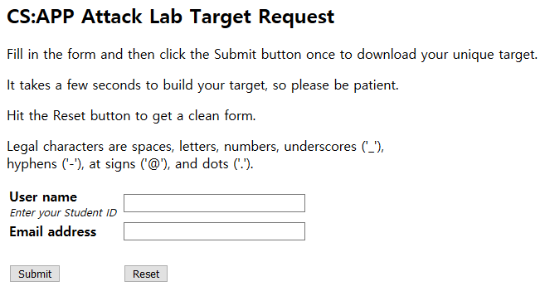
Get your target file
You can obtain your target from http://csedell.pusan.ac.kr:15217/
targetk.tar (k is the unique number)
자신의 학번
자신의 이메일 주소

Slide 15
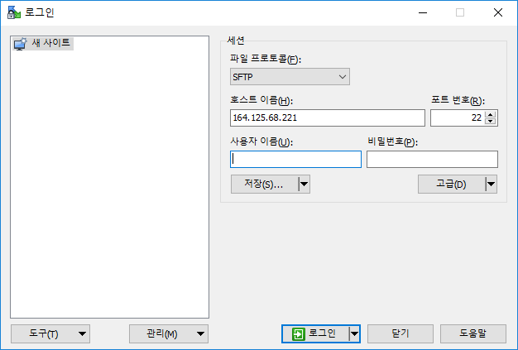
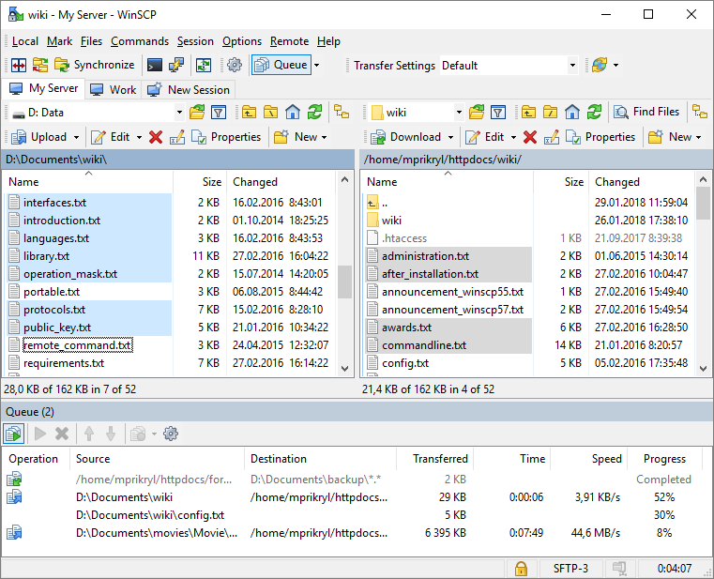
Get your target file
Move your targetk.tar file to csedell.pusan.ac.kr
Use WinSCP
https://winscp.net/eng/download.php

Slide 16
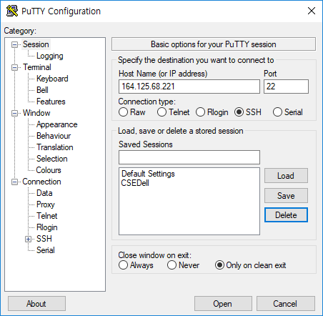
Get your target file
Extract your targetk.tar file on csedell.pusan.ac.kr
Use putty for SSH connection
https://www.chiark.greenend.org.uk/~sgtatham/putty/latest.html
tar -xvf targetk.tar

Slide 17
Get your target file
The files in targetk include
README.txt: A file describing the contents of the directory
ctarget: An executable program vulnerable to code-injection attacks
rtarget: An executable program vulnerable to return-oriented-programming attacks
cookie.txt: An 8-digit hex code that you will use as a unique identifier in your attacks.
farm.c: The source code of your target’s “gadget farm,” which you will use in generating return-oriented programming attacks.
hex2raw: A utility to generate attack strings.
IMPORTANT NOTE: You can work on your solution only on the CSEDell machine.

Slide 18
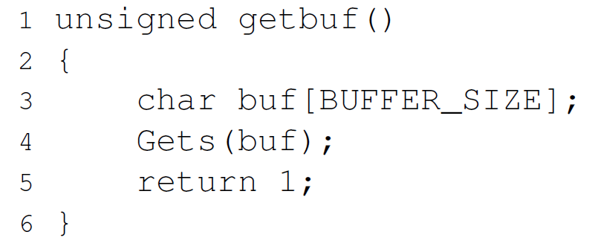
Target Programs
Both CTARGET and RTARGET read strings from standard input with the function getbuf
It has buffer overflow vulnerability

Slide 19
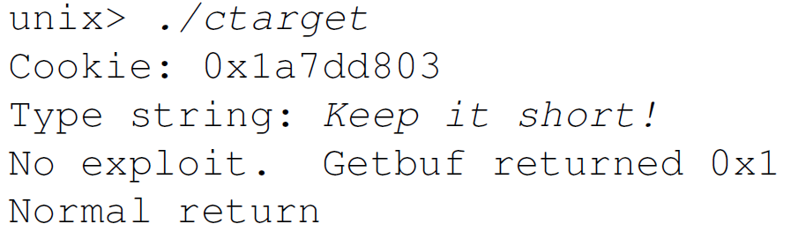
Target Programs
If the string typed by the user and read by getbuf is sufficiently short

Slide 20
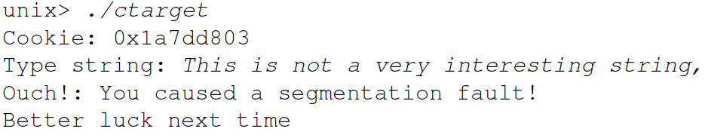
Target Programs
Typically an error occurs if you type a long string

Slide 21
Target Programs
Command line arguments
-h: Print list of possible command line arguments
-q: Don’t send results to the grading server
-i FILE: Supply input from a file, rather than from standard input

Slide 22
Attack Lab Overview
HEX2RAW
Your exploit strings will typically contain byte values that do not correspond to the ASCII values for printing characters.
The program HEX2RAW can help you generate these raw strings.
HEX2RAW also supports C-style block comments
# echo "30 31 32 33 34 35" | ./hex2raw
012345
# cat exploit.txt | ./hex2raw | ./ctarget
bf 66 7b 32 78 /* mov $0x78327b66,%edi */

Slide 23
Attack Lab Overview
Important points
Your exploit string must not contain byte value 0x0A (‘\n’) at any intermediate position
HEX2RAW expects two-digit hex values separated by a whitespace
../hex2raw < ctarget.l2.txt | ../ctarget
Cookie: 0x1a7dd803
Type string:Touch2!: You called touch2(0x1a7dd803)
Valid solution for level 2 with target ctarget
PASSED: Sent exploit string to server to be validated.
NICE JOB!

Slide 24
Attack Lab Overview
Auto grading server
When you have correctly solved one of the levels, your target program will automatically send a notification to the grading server.
Unlike the Bomb Lab, there is no penalty for making mistakes in this lab.
You can view the scoreboard by pointing your Web browser at http://csedell.pusan.ac.kr:15217/scoreboard

Slide 25
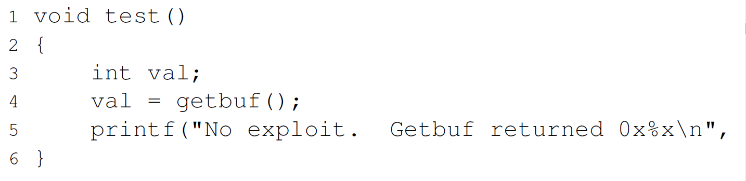
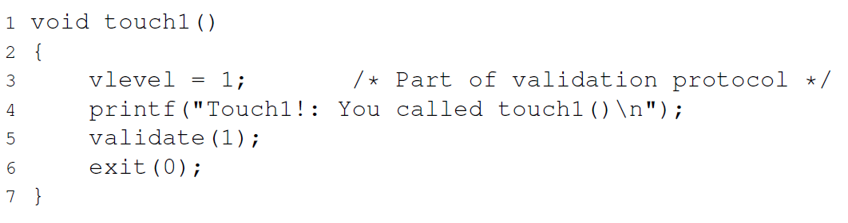
Phase1: Code Injection Attacks: CTARGET
Level 1
Your task is to get CTARGET to execute the code for touch1 when getbuf executes its return statement, rather than returning to test.

Slide 26
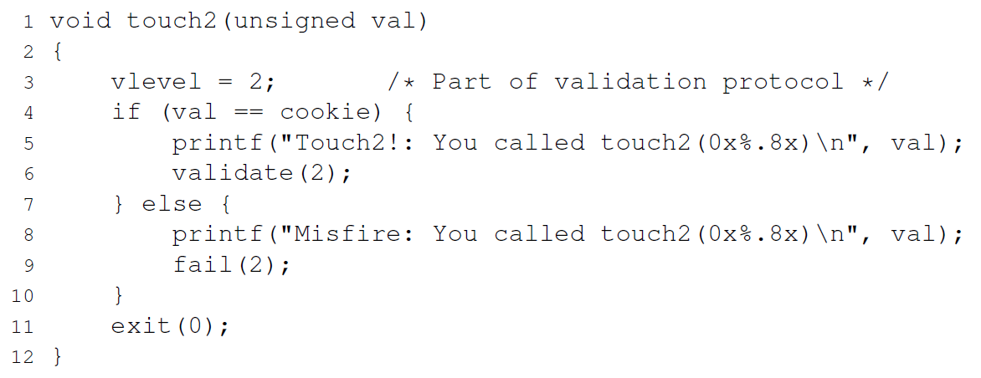
Phase2: Code Injection Attacks: CTARGET
Level 2
Your task is to get CTARGET to execute the code for touch2 rather than returning to test. In this case, however, you must make it appear to touch2 as if you have passed your cookie as its argument.

Slide 27
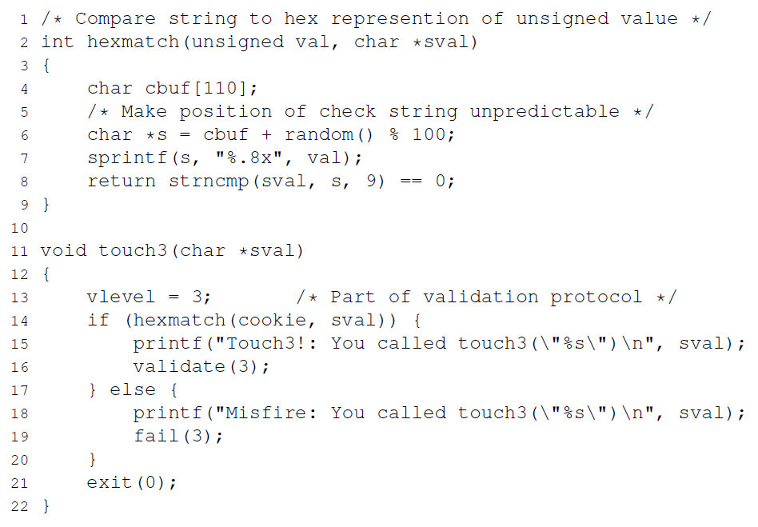
Phase3: Code Injection Attacks: CTARGET
Level 3
Your task is to get CTARGET to execute the code for touch3 rather than returning to test. You must make it appear to touch3 as if you have passed a string representation of your cookie as its argument.

Slide 28
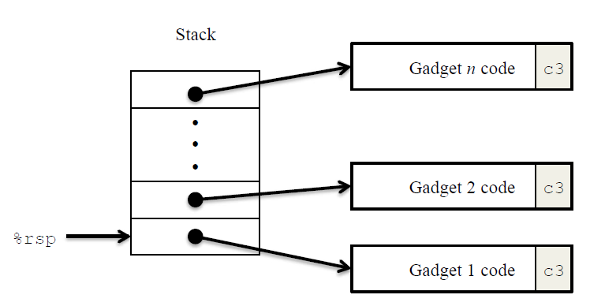
Return-Oriented Programming(ROP)
It uses randomization so that the stack positions differ from one run to another. This makes it impossible to determine where your injected code will be located.
It marks the section of memory holding the stack as nonexecutable, so even if you could set the program counter to the start of your injected code, the program would fail with a segmentation fault.

Slide 29
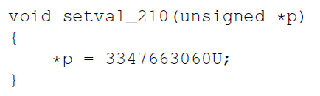
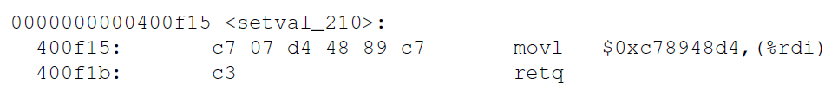
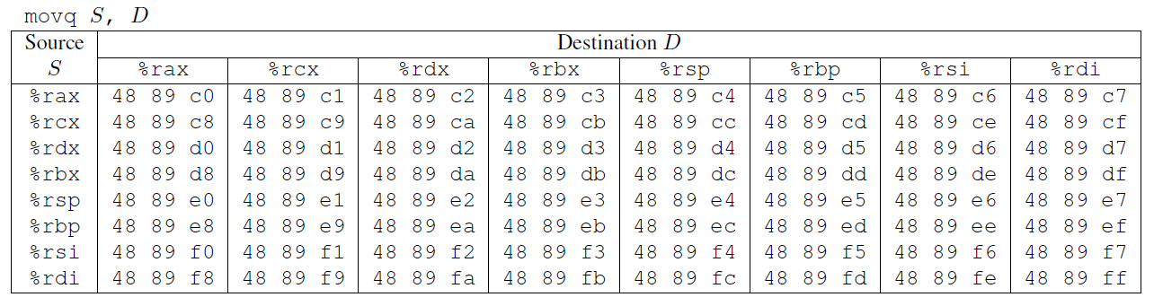
Return-Oriented Programming(ROP)
For example, rtarget contains the following C function.
48 89 c7
movq %rax, %rdi
starts at address 0x400f18

Slide 30
Return-Oriented Programming(ROP)
Your code for RTARGET contains a number of functions similar to the setval_210 function
We refer to as the gadget farm
Your job will be to identify useful gadgets in the gadget farm and use these to perform attacks similar to those you did in Phases 2 and 3

Slide 31
Phase4: ROP Level2 : RTARGET
You will repeat the attack of Phase 2, but do so on program RTARGET using gadgets from your gadget farm.
You can construct your solution using gadgets consisting of the following instruction types, and using only the first eight x86-64 registers (%rax–%rdi).

Slide 32
Phase4: ROP Level2 : RTARGET
You can find byte encodings of more instructions on the writeup
movq, popq, movl
ret : This instruction is encoded by the single byte 0xc3.
nop : This instruction (pronounced “no op,” which is short for “no operation”) is encoded by the single byte 0x90. Its only effect is to cause the program counter to be incremented by 1.

Slide 33
Phase5 : ROP Level 3: RTARGET
Phase 5 requires you to do an ROP attack on RTARGET to invoke function touch3 with a pointer to a string representation of your cookie.

Slide 34
Generating Byte Codes
Use gcc and objdump to generate byte codes for assembly instruction sequences
example.s
# Example of hand-generated assembly code
push $0xabcdef # Push value onto stack
add $17,%eax # Add 17 to %eax
movl %eax,%edx # Copy lower 32 bits to %edx
This string can then be passed through HEX2RAW to generate an input string for the target programs
ubuntu# gcc -c example.S
ubuntu# objdump -d example.o > example.d
example.d
68 ef cd ab 00 48 83 c0 11 89 c2
example.o: file format elf64-x86-64
Disassembly of section .text:
0000000000000000 <.text>:
0: 68 ef cd ab 00 pushq $0xabcdef
5: 48 83 c0 11 add $0x11,%rax
9: 89 c2 mov %eax,%edx
OR
68 ef cd ab 00 /* push $0xabcdef */
83 c0 11 /* add $0x11,%eax */
89 c2 /* mov %eax,%edx */

Slide 35
Summary
Download your target and attack it!
http://csedell.pusan.ac.kr:15217
제출기한 : PLATO 공지
하루 딜레이당 15% 감점
반드시 실습 서버(CSEDell) 에서 수행할 것!!
(그 외의 환경에서는 실행 불가)

Slide 36
Summary
제출물
targetID_학번.docx: 각 phase에서 자신이 attack을 수행한 과정을 간략히 설명
MS워드 파일로 작성(pdf, hwp도 ok)
표지없이 간단히 첫 장 상단에 이름과 학번만 명시
5장을 넘지 말 것, 초과시 보고서 점수 감점 사유.
PLATO로 제출
targetID_sol.tar: 각 phase별 solution file들을 tar로 압축한 파일
각 solution file 이름: targetID.p1, targetID.p2, targetID.p3, targetID.p4, targetID.p5
아래와 같이 실행 가능 해야함
> cat target.p1 | ./hex2raw | ./ctarget
> tar –cvf targetID_sol.tar targetID.p1, targetID.p2, targetID.p3, targetID.p4, targetID.p5
TargetID.p1

Slide 37
Questions?

